Slide 1
ARRAYS

Slide 2
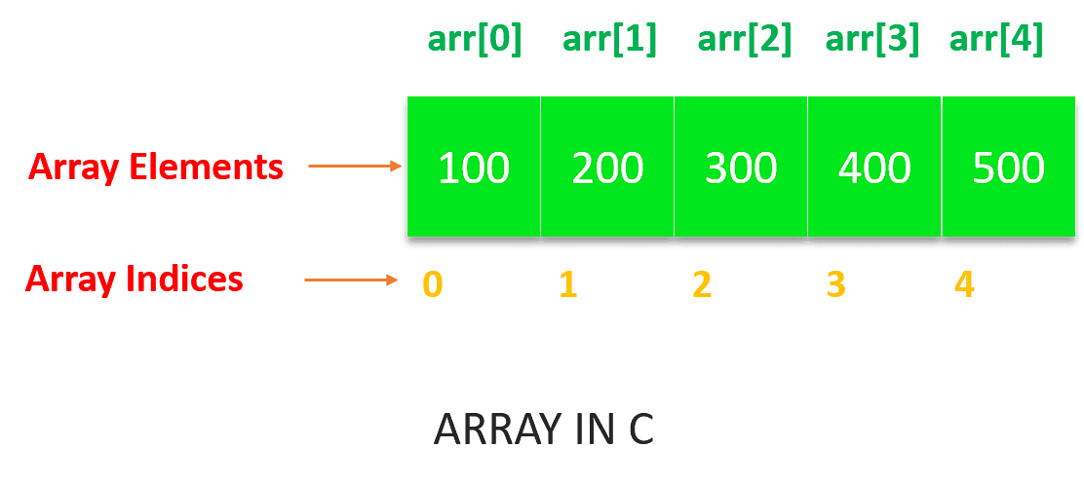
Arrays:
Array is a fundamental data structure in C.
An array is a collection of similar types of data items stored in a single unit.
One or more values same data type, which may be primary data types (int, float, char), or user−defined types such as struct, or pointers can be stored in an array.
The size of the array, also called the length of the array,
Once declared, the size of a array cannot be changed.

Slide 3
Array declaration:
To declare an array in C, to specify the type of the elements and the number of elements to be stored in it.
Syntax:
datatype arrayName [ Size ]; EX: int number[5];
Datatype → specify the type of element stored in array
arrayName → giving name to array
Size → number of elements present in the array
Note:
The Size must be an integer constant greater than zero and type can be any valid C data type. The size is put inside the square brackets.

Slide 4
Array initialization:
Syntax:
data_type array_variable_name[size] = {list of value};
Example:
To store 5 (10, 20, 30, 40, 50 ) elements in an array.
int number[5] = {10, 20, 30, 40, 50 };
Number[0]
Number[1]
Number[2]
Number[3]
Number[4]
10
20
30
40
50

Slide 5
Example:
int counter[] = {10,20,30,40,50}; // array with integer
char name[] = {‘j’, ‘o’, ‘h’, ‘n’}; // array with char
char name[] = “john”; // array with string
int number[5] = {10, 20};
number[0] = 10
number[1] = 20
number[2] = 0
number[3] = 0
number[4] = 0
Ex:
int x[5];
printf(“Enter values:”);
scanf(“%d%d%d”, &x[0], &x[1], &x[2]);

Slide 6
Types of array:
One dimensional array
Two dimensional array
Multi dimensional array
One dimensional array:
Syntax:
datatype arrayName [ Size ];
Example:
int number[5];

Slide 7
Declaring uninitialized array:
Example:
int a[5];
In such type of declaration, the uninitialized elements in the array may show certain random garbage values.
Program:
#include<stdio.h>
int main(){
int a[5];
for(int i=0;i<5;i++){
printf("a[%d] : %d\n",i,a[i]);
}
return 0;
}
Output:
a[0] : 0
a[1] : 0
a[2] : 52
a[3] : 0
a[4] : 0

Slide 8
Declaring initialized array:
Example:
int arr[5] = {1,2,3,4,5};
Program:
#include<stdio.h>
int main(){
int a[5]={1,2,3,4,5};
for(int i=0;i<5;i++){
printf("a[%d] = %d\n",i,a[i]);
}
return 0;
}
Output:
a[0] = 1
a[1] = 2
a[2] = 3
a[3] = 4
a[4] = 5

Slide 9
Program:
#include<stdio.h>
int main(){
int a[5]={1,2};
for(int i=0;i<5;i++){
printf("a[%d] = %d\n",i,a[i]);
}
return 0;
}
Output:
a[0] = 1
a[1] = 2
a[2] = 0
a[3] = 0
a[4] = 0

Slide 10
Program:
#include<stdio.h>
int main(){
int a[5]={1,2,3,4,5};
printf("Size of array = %d",sizeof(a));
return 0;
}
Output:
Size of array = 20

Slide 11
Program:
#include<stdio.h>
int main(){
int a[5];
printf("Enter 5 numbers :\n");
for(int i=0;i<5;i++){
scanf("%d",&a[i]);
}
for(int i=0;i<5;i++){
printf("\na[%d] = %d",i,a[i]);
}
return 0;
}
Output:
Enter 5 numbers :
1
2
3
4
5
a[0] = 1
a[1] = 2
a[2] = 3
a[3] = 4
a[4] = 5

Slide 12
Program:
#include<stdio.h>
int main(){
int a[5],i,sum=0;
printf("Enter 5 numbers :\n");
for(i=0;i<5;i++){
scanf("%d",&a[i]);
sum=sum+a[i];
}
printf("Sum = %d\n",sum);
return 0;
} }
Output:
Enter 5 numbers :
1
2
3
4
5
Sum = 15

Slide 13
Two dimensional array:
Syntax:
data_type array_name [row_size][column_size];
Initializing two dimensional array:
Example:
int table[2][3] = {0,0,01,1,1};
int table[2][3] = {{0,0,0},{1,1,1}}
Assign the values as follow,
table[0][0] = 0
table[0][1] = 0
table[0][2] = 0
table[1][0] = 1
table[1][1] = 1
table[1][2] = 1
0 1 2
0 0 0 0
1 1 1 1

Slide 14
Program: (two dimensional array)
#include<stdio.h>
int main(){
int a[2][4]={{1,2,3,4},{5,6,7,8}};
printf("Value of a[1][2] = %d\n",a[1][2]);
a[1][2]=24;
printf("Value of a[1][2] = %d\n\n",a[1][2]);
for(int i=0;i<2;i++){
for(int j=0;j<4;j++){
printf("a[%d][%d] = %d\n",i,j,a[i][j]);
}
}
return 0;
}
Output:
Value of a[1][2] = 7
Value of a[1][2] = 24
a[0][0] = 1
a[0][1] = 2
a[0][2] = 3
a[0][3] = 4
a[1][0] = 5
a[1][1] = 6
a[1][2] = 24
a[1][3] = 8

Slide 15
Program:(matrix addition)
#include<stdio.h>
int main(){
int m,n,i,j,a[10][10],b[10][10],sum[10][10];
printf("Enter row and column : ");
scanf("%d %d",&m,&n);
printf("Enter first matrix :\n");
for(i=0;i<m;i++){
for(j=0;j<n;j++){
scanf("%d",&a[i][j]);
}
}
printf("Enter second matrix :\n");
for(i=0;i<m;i++){
for(j=0;j<n;j++){
scanf("%d",&b[i][j]);
}
}

Slide 16
for(i=0;i<m;i++){
for(j=0;j<n;j++){
sum[i][j]=a[i][j]+b[i][j];
}
}
printf("Sum of matrixes : \n");
for(i=0;i<m;i++){
for(j=0;j<n;j++){
printf("%d\t",sum[i][j]);
}
printf("\n");
}
return 0;
}

Slide 17
Output:
Enter row and column : 2 2
Enter first matrix :
1 1
1 1
Enter second matrix :
1 1
1 1
Sum of matrixes :
2 2
2 2

Slide 18
Multi dimensional array:
Array of more dimensions are called multi dimension array.
Syntax:
data_type array_name[s1][s2][s3][s4]……[sn]
where,
s → size of dimension:
Example:
int survey[3][5][2];
float table[5][4][5][3];

